Slide 1

Session - 8

Slide 2
Content
Commanding
Binding
MVVM
Bindable Properties
Attached Property

Slide 3
Commanding
With commanding, data bindings can make method calls directly to a ViewModel from the following classes:
Button
MenuItem
ToolbarItem
SearchBar
TextCell
ImageCell
ListView
TapGestureRecognizer
To support commanding, two public properties are defined on the majority of these classes:
Command, of type System.Windows.Input.ICommand.
CommandParameter, of type object.

Slide 4
Command Interface
The commanding interface provides an alternative approach to implementing commands that is much better suited to the MVVM architecture. The ViewModel itself can contain commands, which are methods that are executed in reaction to a specific activity in the View such as a Button click. Data bindings are defined between these commands and the Button.
To allow a data binding between a Button and a ViewModel, the Button defines two properties:
Command of type ICommand
CommandParameter of type Object
To use the command interface, you define a data binding that targets the Command property of the Button where the source is a property in the ViewModel of type ICommand. The ViewModel contains code associated with that ICommand property that is executed when the button is clicked. You can set CommandParameter to arbitrary data to distinguish between multiple buttons if they are all bound to the same ICommand property in the ViewModel.

Slide 5
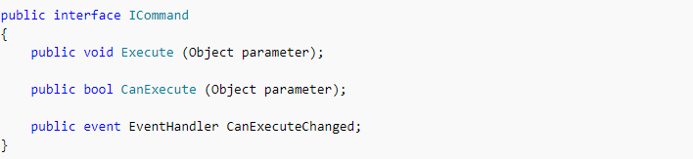

ICommand Interface
The ICommand interface is not part of Xamarin.Forms. It is defined instead in the System.Windows.Input namespace, and consists of two methods and one event:
To use the command interface, your ViewModel contains properties of type ICommand:
The ViewModel must also reference a class that implements the ICommand interface. In the View, the Command property of a Button is bound to that property:

Slide 6
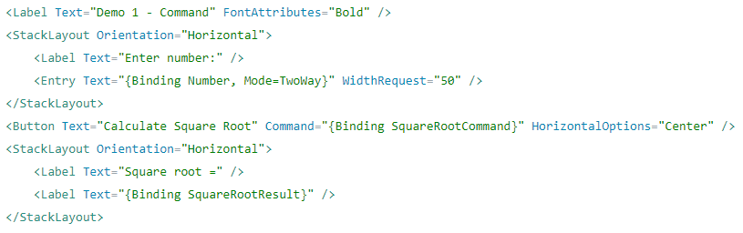
Xaml

Slide 7
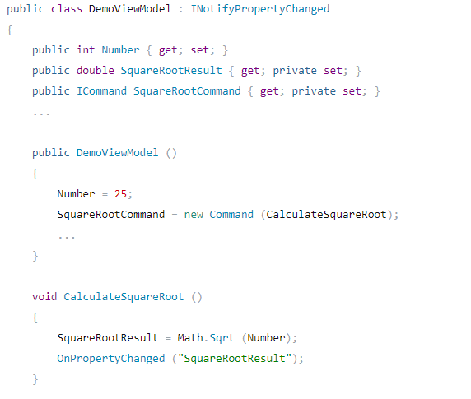
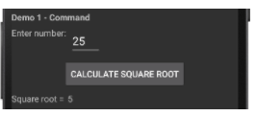
Code Behind

Slide 8
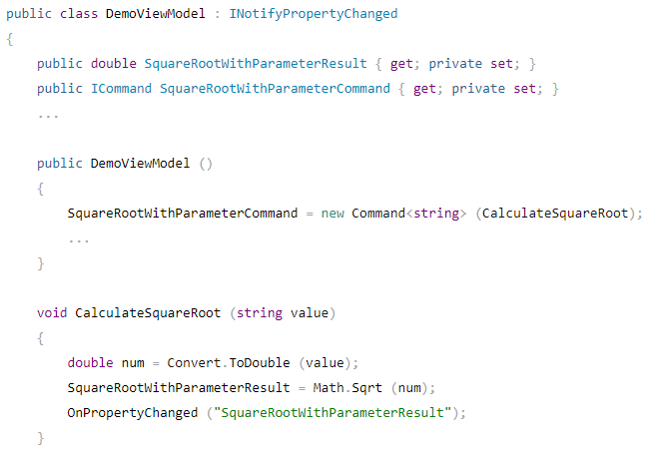
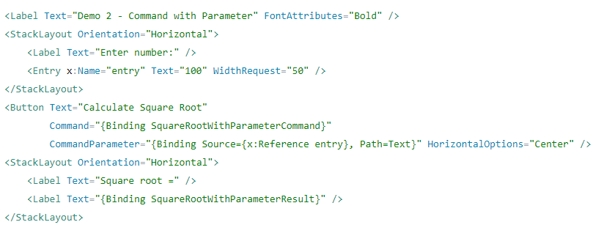
Passing a Parameter to a Command
A parameter can be passed to an ICommand.Execute method by using the Command<T> class to instantiate the command.

Slide 9
Data Binding
Data bindings allow properties of two objects to be linked so that a change in one causes a change in the other.
Data bindings connect properties of two objects, called the source and the target.
The BindingContext property of the target object must be set to the source object, and the SetBinding method must be called on the target object to bind a property of that object to a property of the source object.
Multiple ways to set the BindingContext of the target object:-
From the code-behind file
Using a StaticResource or x:Static markup extension
Sometimes as the content of BindingContext property-element tags.

Slide 10
The Binding class derives from BindingBase and encapsulates many characteristics of a data binding
The BindingContext property is defined by the BindableObject class
The SetBinding method is also defined by the BindableObject class
The BindableObjectExtensions class defines three additional SetBinding methods

Slide 11
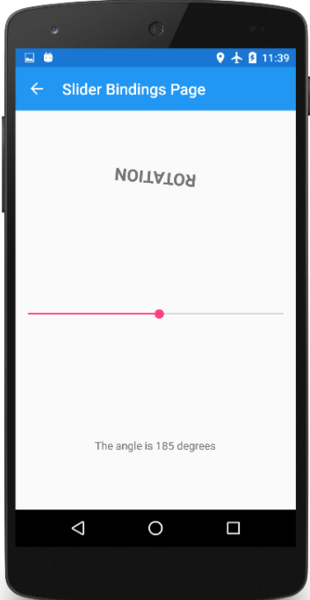
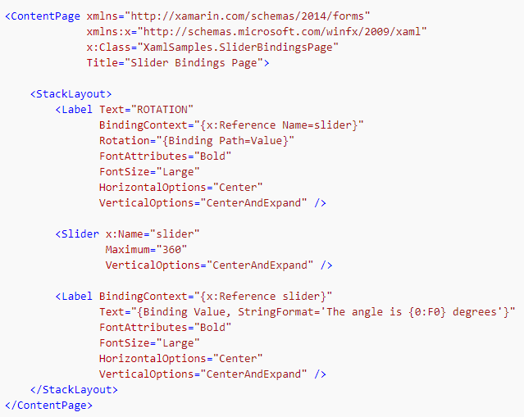
View-to-View Binding
Data bindings to link properties of two views on the same page can be defined. The BindingContext of targetobject should be set using x:Reference markup.

Slide 12
Binding Mode
Mode is used to provide the direction in which property value changes are made.
Different Binding Modes:-
Default
OneWay
OneWayToSource
TwoWay

Slide 13
One Way Binding
This binding mode transfers values from the ViewModel to the View
whenever the property changes within the ViewModel, then the corresponding View property is automatically adjusted.
This binding mode is useful when showing, for example, data which is arriving from a dynamic source - like from a sensor or from a network data feed.
In Xaml, this is very often the default binding mode - so it is the mode used when no other is selected.
One-Way-To-Source
This binding mode transfers values from the View to the ViewModel
When the View property changes then the corresponding ViewModel will be updated.
This binding mode is useful when collecting new data from a user - e.g. when a user fills in a blank form.
In practice, this binding mode is rarely used - most developers choose to use Two-Way instead.
Two-Way
This binding mode transfers values in both directions
Changes in both View and ViewModel properties are monitored - if either changes, then the other will be updated.
This binding mode is useful when editing entries an existing form, and is very commonly used by developers.

Slide 14
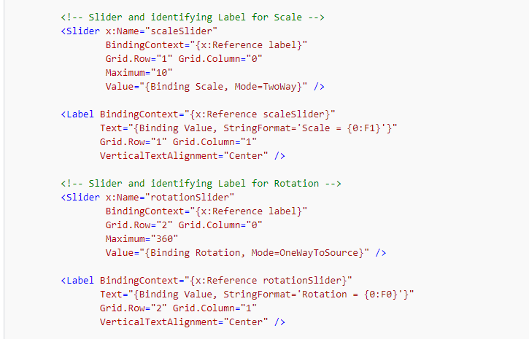
Defining Modes in Xaml

Slide 15
Binding Path
Path is used to specify property name of the source object, which is used for binding.
The Time property of TimePicker is of type TimeSpan, but perhaps you want to create a data binding that references the TotalSeconds property of that TimeSpan value. Here's the data binding:
The Time property is of type TimeSpan, which has a TotalSeconds property. The Time and TotalSeconds properties are simply connected with a period. The items in the Path string always refer to properties and not to the types of these properties.

Slide 16
MVVM
One of the best ways to architect an application is by separating the user interface from the underlying code, which is sometimes called the business logic. Several techniques exist, but the one that is tailored for XAML-based environments is known as Model-View-ViewModel
The pattern enforces a separation between three software layers — the XAML user interface, called the View; the underlying data, called the Model; and an intermediary between the View and the Model, called the ViewModel.
The View and the ViewModel are often connected through data bindings defined in the XAML file. The BindingContext for the View is usually an instance of the ViewModel.

Slide 17
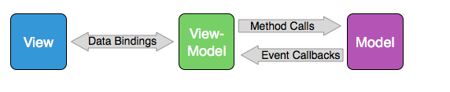
MVVM Interrelationship
An MVVM application has three layers:
The Model provides underlying data, sometimes through files or web accesses
The View is the user interface or presentation layer, generally implemented in XAML
The ViewModel connects the Model and the View
The Model is ignorant of the ViewModel and the ViewModel is ignorant of the View. These three layers generally connect to each other using the following mechanisms:

Slide 18
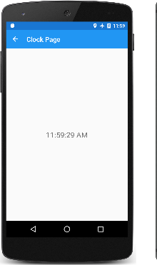
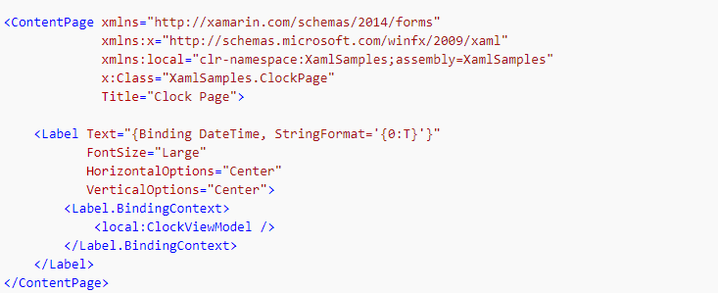
View

Slide 19
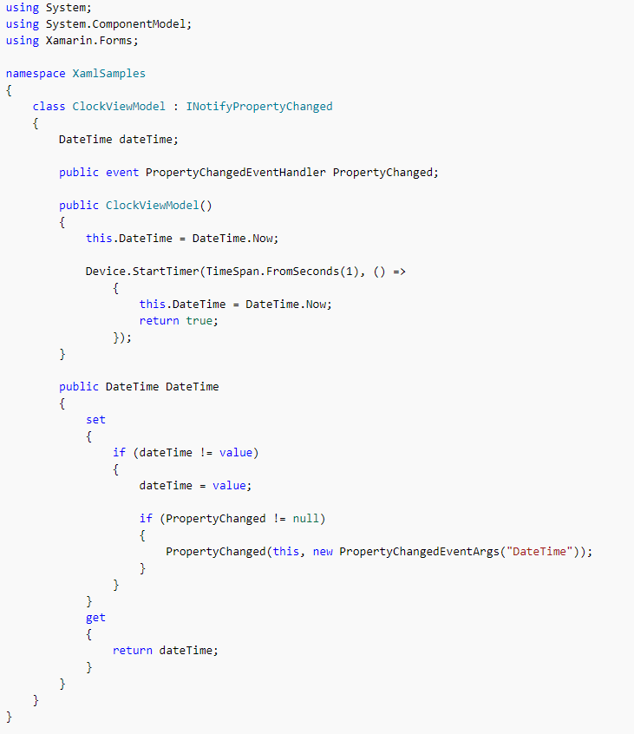
View Model

Slide 20
View Models and Data binding
To engage in data bindings, a ViewModel must be capable of notifying the View when a property of the ViewModel has changed.
This is done by implementing the INotifyPropertyChanged interface in the System.ComponentModel namespace. This is part of .NET rather than Xamarin.Forms. (Generally ViewModels attempt to maintain platform independence.)
The INotifyPropertyChanged interface declares a single event named PropertyChanged that indicates the property that has changed.
INotifyPropertyChanged
The INotifyPropertyChanged interface is used to notify clients, typically binding clients, that a property value has changed.
For change notification to occur in a binding between a bound client and a data source, your bound type should either:
Implement the INotifyPropertyChanged interface (preferred).
Provide a change event for each property of the bound type.

Slide 21
Bindable Properties
A bindable property is a special type of property, where the property's value is tracked by the Xamarin.Forms property system.
Bindable properties extend CLR property functionality by backing a property with a BindableProperty type, instead of backing a property with a field.
Properties should be implemented as bindable properties to support one or more of the following features:
Acting as a valid target property for data binding.
Setting the property through a style.
Providing a default property value that's different from the default for the type of the property.
Validating the value of the property.
Monitoring property changes.
Note : All BindableProperty instances must be created on the UI thread. This means that only code that runs on the UI thread can get or set the value of a bindable property. However, BindableProperty instances can be accessed from other threads by marshaling to the UI thread with the Device.BeginInvokeOnMainThread method.

Slide 22
Creating Property
A bindable property can be created by declaring a public static readonly property of type BindableProperty.
The bindable property should be set to the returned value of one of the BindableProperty.
Create method overloads.
The declaration should be within the body of BindableObject derived class, but outside of any member definitions.
At a minimum, an identifier must be specified when creating a BindableProperty, along with the following parameters:
The name of the BindableProperty.
The type of the property.
The type of the owning object.
The default value for the property. This ensures that the property always returns a particular default value when it is unset, and it can be different from the default value for the type of the property. The default value will be restored when the ClearValue method is called on the bindable property.

Slide 23
Optionally, when creating a BindableProperty instance, the following parameters can be specified:
The binding mode, used to specify the direction in which property value changes will propagate. In the default binding mode, changes will propagate from the source to the target.
A validation delegate that will be invoked when the property value is set. For more information, see Validation Callbacks.
A property changed delegate that will be invoked when the property value has changed. For more information, see Detecting Property Changes.
A property changing delegate that will be invoked when the property value will change. This delegate has the same signature as the property changed delegate.
A coerce value delegate that will be invoked when the property value has changed. For more information, see Coerce Value Callbacks.
A Func that's used to initialize a default property value. For more information, see Creating a Default Value with a Func.

Slide 24
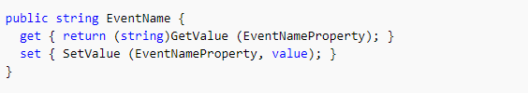
Creating Accessors
Property accessors are required to use property syntax to access a bindable property.
The Get accessor should return the value that's contained in the corresponding bindable property. This can be achieved by calling the GetValue method, passing in the bindable property identifier on which to get the value, and then casting the result to the required type.
The Set accessor should set the value of the corresponding bindable property. This can be achieved by calling the SetValue method, passing in the bindable property identifier on which to set the value, and the value to set.

Slide 25

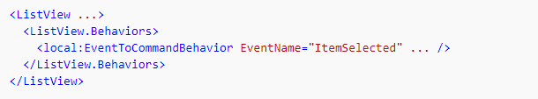
Consuming Bindable Property
After creating bindable property, it can be consumed from XAML or code. In XAML, this is achieved by declaring a namespace with a prefix, with the namespace declaration indicating the CLR namespace name, and optionally, an assembly name.
Declaring local
This namespace declaration is used when setting the EventName bindable property

Slide 26
Attached Property
An attached property is a special type of bindable property, defined in one class but attached to other objects, and recognizable in XAML as an attribute that contains a class and a property name separated by a period.
Bindable properties should be implemented as attached properties in the following scenarios:
When there's a need to have a property setting mechanism available for classes other than the defining class.
When the class represents a service that needs to be easily integrated with other classes.

Slide 27
Creating Property
An attached property can be created by declaring a public static readonly property of type BindableProperty. The bindable property should be set to the returned value of one of the BindableProperty.CreateAttached method overloads. The declaration should be within the body of the owning class, but outside of any member definitions.
This creates an attached property named HasShadow, of type bool. The property is owned by the ShadowEffect class, and has a default value of false. The naming convention for attached properties is that the attached property identifier must match the property name specified in the CreateAttached method, with "Property" appended to it.

Slide 28
Creating Accessors
Static GetPropertyName and SetPropertyName methods are required as accessors for the attached property, otherwise the property system will be unable to use the attached property. The GetPropertyName accessor should conform to the following signature:
The GetPropertyName accessor should return the value that's contained in the corresponding BindableProperty field for the attached property. This can be achieved by calling the GetValue method, passing in the bindable property identifier on which to get the value, and then casting the resulting value to the required type.
The SetPropertyName accessor should conform to the following signature:
The SetPropertyName accessor should set the value of the corresponding BindableProperty field for the attached property. This can be achieved by calling the SetValue method, passing in the bindable property identifier on which to set the value, and the value to set

Slide 29


Consuming Attached Property
In XAML, this is achieved by declaring a namespace with a prefix, with the namespace declaration indicating the Common Language Runtime (CLR) namespace name, and optionally an assembly name.
Defining local
Using local accessing attached Property in Xaml
Accessing attached Property in Code Behind

